Slide 1
Publisher-Subscriber pattern
Juan Luis Gorricho

Slide 2
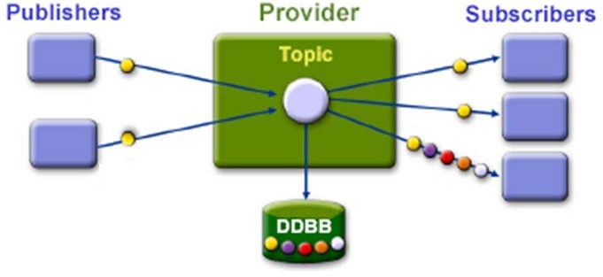

Publisher/Subscriber Pattern
Messages are classified by topics
Publishers send messages by topic
Subscribers register to specific topics

